Slide 1

Chapter 4
IP Addresses:
Classful Addressing
Objectives
Upon completion you will be able to:
Understand IPv4 addresses and classes
Identify the class of an IP address
Find the network address given an IP address
Understand masks and how to use them
Understand subnets and supernets
TCP/IP Protocol Suite

Slide 2
4.1 INTRODUCTION
4.1 INTRODUCTION
The identifier used in the IP layer of the TCP/IP protocol suite to identify each device connected to the Internet is called the Internet address or IP address. An IP address is a 32-bit address that uniquely and universally defines the connection of a host or a router to the Internet. IP addresses are unique. They are unique in the sense that each address defines one, and only one, connection to the Internet. Two devices on the Internet can never have the same address.
The topics discussed in this section include:
Address Space
Notation
TCP/IP Protocol Suite

Slide 3

Note:
An IP address is a 32-bit address.
TCP/IP Protocol Suite

Slide 4
Note:
The IP addresses are unique.
TCP/IP Protocol Suite

Slide 5
Note:
The address space of IPv4 is
2³² or 4,294,967,296.
TCP/IP Protocol Suite

Slide 6
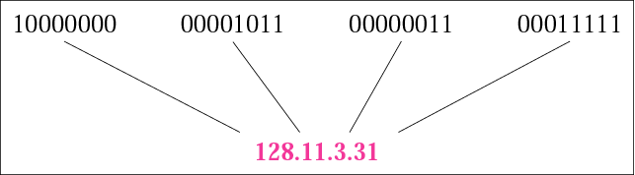
Figure 4.1 Dotted-decimal notation
TCP/IP Protocol Suite

Slide 7
Example 1
Change the following IP addresses from binary notation to dotted-decimal notation.
a. 10000001 00001011 00001011 11101111
b. 11000001 10000011 00011011 11111111
c. 11100111 11011011 10001011 01101111
d. 11111001 10011011 11111011 00001111
Solution
a. 129.11.11.239
b.193.131.27.255
c. 231.219.139.111
d. 249.155.251.15
TCP/IP Protocol Suite

Slide 8
Example 2
Change the following IP addresses from dotted-decimal notation to binary notation.
a. 111.56.45.78 b. 221.34.7.82
c. 241.8.56.12 d. 75.45.34.78
Solution
We replace each decimal number with its binary equivalent:
a. 01101111 00111000 00101101 01001110
b. 11011101 00100010 00000111 01010010
c. 11110001 00001000 00111000 00001100
d. 01001011 00101101 00100010 01001110
TCP/IP Protocol Suite
Ans

Slide 9
Example 3
Find the error, if any, in the following IP addresses:
a. 111.56.045.78 b. 221.34.7.8.20
c. 75.45.301.14 d. 11100010.23.14.67
Solution
a. There are no leading zeroes in dotted-decimal notation (045).
b. We may not have more than four numbers in an IP address.
c. In dotted-decimal notation, each number is less than or equal
to 255; 301 is outside this range.
d. A mixture of binary notation and dotted-decimal notation is not
allowed.
Ans
TCP/IP Protocol Suite

Slide 10
Example 4
Change the following IP addresses from binary notation to hexadecimal notation.
a. 10000001 00001011 00001011 11101111
b. 11000001 10000011 00011011 11111111
Solution
We replace each group of 4 bits with its hexadecimal equivalent (see Appendix B). Note that hexadecimal notation normally has no added spaces or dots; however, 0X (or 0x) is added at the beginning or the subscript 16 at the end to show that the number is in hexadecimal.
a. 0X810B0BEF or 810B0BEF₁₆
b. 0XC1831BFF or C1831BFF₁₆
TCP/IP Protocol Suite

Slide 11
4.2 CLASSFUL ADDRESSING
IP addresses, when started a few decades ago, used the concept of classes. This architecture is called classful addressing.
In the mid-1990s, a new architecture, called classless addressing, was introduced and will eventually supersede the original architecture.
However, part of the Internet is still using classful addressing, but the migration is very fast.
TCP/IP Protocol Suite

Slide 12
4.2 CLASSFUL ADDRESSING
The topics discussed in this section include:
Recognizing Classes
Netid and Hostid
Classes and Blocks
Network Addresses
Sufficient Information
Mask
CIDR Notation
Address Depletion
TCP/IP Protocol Suite

Slide 13
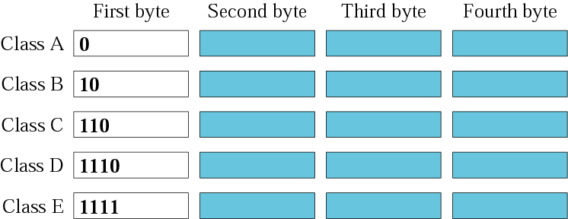
Figure 4.3 Finding the class in binary notation
TCP/IP Protocol Suite

Slide 14
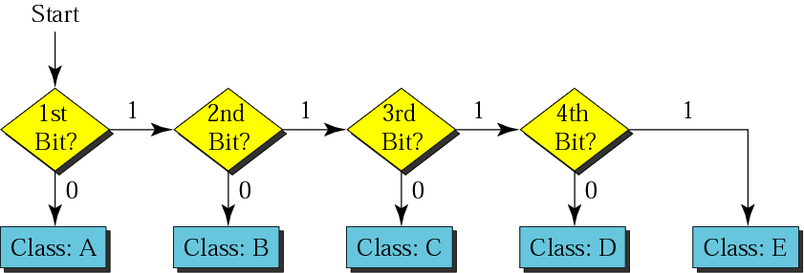
Figure 4.4 Finding the address class
TCP/IP Protocol Suite

Slide 15

Figure 4.5 Finding the class in decimal notation
TCP/IP Protocol Suite

Slide 16
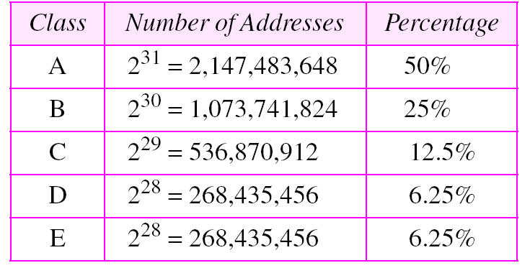
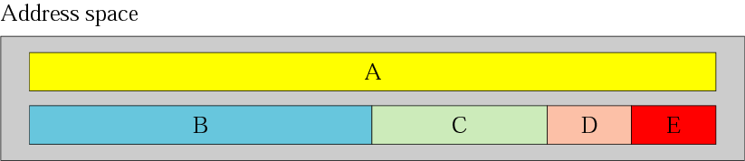
Figure 4.2 Occupation of the address space

Slide 17
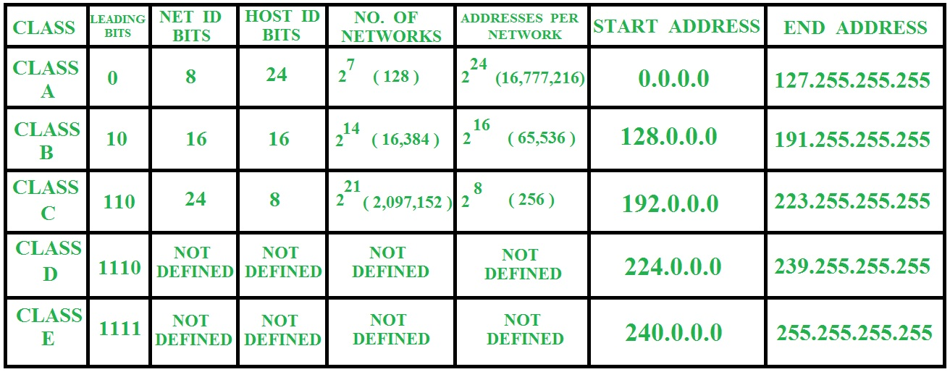
TCP/IP Protocol Suite

Slide 18
Class A addresses were designed for large organizations with a large number of attached hosts or routers.
Class B addresses were designed for midsize organizations with tens of thousands of attached hosts or routers.
Class C addresses were designed for small organizations with a small number of attached hosts or routers
TCP/IP Protocol Suite

Slide 19
N/W Id - 191.17.0.0 255.255.0.0
Start IP 191.17.0.1
End IP 191.17.255.254
B/C Id - 191.17.255.255
0.0.0.0 booting
127.xx.yy.zz will be used for loop back testing
All the network bits set as 1
and all the host bits set as 0
Subnet Mask
11111111.11111111.00000000.00000000
255 . 255 . 0 . 0
TCP/IP Protocol Suite

Slide 20
Example 5
How can we prove that we have 2,147,483,648 addresses in class A?
Solution
In class A, only 1 bit defines the class. The remaining 31 bits are available for the address. With 31 bits, we can have 2³¹
or 2,147,483,648 addresses.
Ans
TCP/IP Protocol Suite

Slide 21
Example 6
Find the class of each address:
a. 00000001 00001011 00001011 11101111
b. 11000001 10000011 00011011 11111111
c. 10100111 11011011 10001011 01101111
d. 11110011 10011011 11111011 00001111
Ans
Solution
See the procedure in Figure 4.4.
a. The first bit is 0. This is a class A address.
b. The first 2 bits are 1; the third bit is 0. This is a class C address.
c. The first bit is 0; the second bit is 1. This is a class B address.
d. The first 4 bits are 1s. This is a class E address..
TCP/IP Protocol Suite

Slide 22
Example 7
Find the class of each address:
a. 227.12.14.87 b.193.14.56.22 c.14.23.120.8
d. 252.5.15.111 e.134.11.78.56
Solution
a. The first byte is 227 (between 224 and 239); the class is D.
b. The first byte is 193 (between 192 and 223); the class is C.
c. The first byte is 14 (between 0 and 127); the class is A.
d. The first byte is 252 (between 240 and 255); the class is E.
e. The first byte is 134 (between 128 and 191); the class is B.
Ans
TCP/IP Protocol Suite

Slide 23
Example 8
In Example 5 we showed that class A has 2³¹ (2,147,483,648) addresses. How can we prove this same fact using dotted-decimal notation?
Solution
The addresses in class A range from 0.0.0.0 to 127.255.255.255. We need to show that the difference between these two numbers is 2,147,483,648. This is a good exercise because it shows us how to define the range of addresses between two addresses. We notice that we are dealing with base 256 numbers here. Each byte in the notation has a weight. The weights are as follows (see Appendix B):
TCP/IP Protocol Suite

Slide 24
Example 8 (continued)
256³, 256², 256¹, 256⁰
Now to find the integer value of each number, we multiply each byte by its weight:
Last address: 127 × 256³ + 255 × 256² +
255 × 256¹ + 255 × 256⁰ = 2,147,483,647
First address: = 0
If we subtract the first from the last and add 1 to the result (remember we always add 1 to get the range), we get 2,147,483,648 or 2³¹.
TCP/IP Protocol Suite

Slide 25
Netid and Hostid
In classful addressing, an IP address in class A, B, or C is divided into netid and hostid.
These parts are of varying lengths, depending on the class of the address.
Note that the concept does not apply to classes D and E.
In class A, one byte defines the netid and three bytes define the hostid.
In class B, two bytes define the netid and two bytes define the hostid.
In class C, three bytes define the netid and one byte defines the hostid.
TCP/IP Protocol Suite

Slide 26
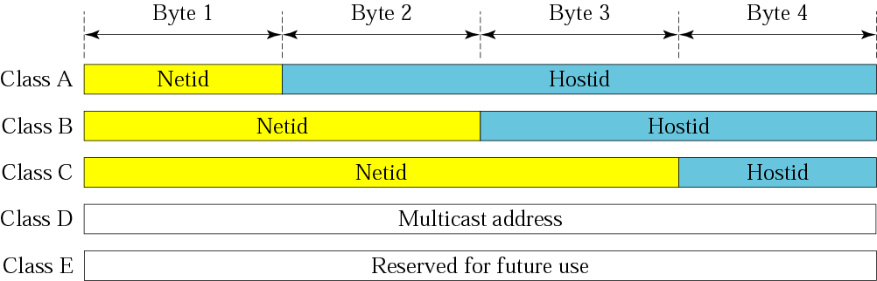
Figure 4.6 Netid and hostid
TCP/IP Protocol Suite

Slide 27
What do you understand by mask?
Although the length of the netid and hostid (in bits) is predetermined in classful addressing, we can also use a mask (also called the default mask), a 32-bit number made of contiguous.
The mask can help us to find the netid and the hostid.
For example, the mask for a class A address has eight 1s, which means the first 8 bits of any address in class A define the netid; the next 24 bits define the hostid.
TCP/IP Protocol Suite

Slide 28
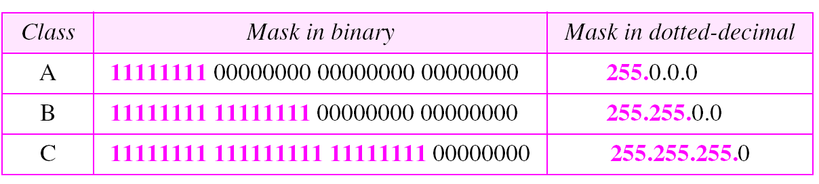
Table 4.2 Default masks
TCP/IP Protocol Suite

Slide 29
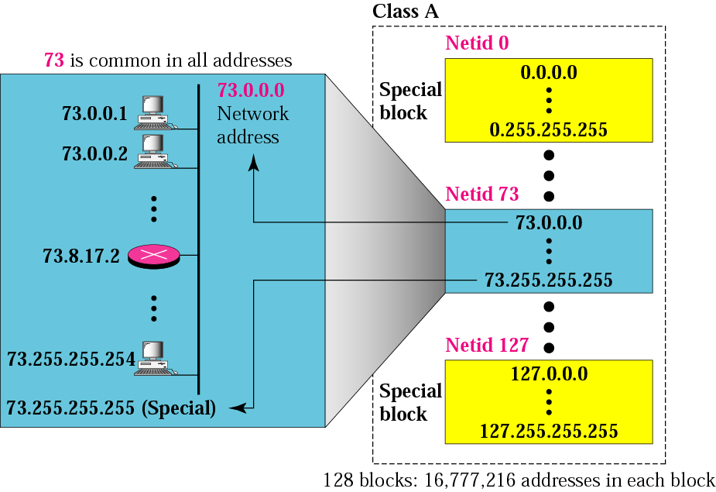
Figure 4.7 Blocks in class A
TCP/IP Protocol Suite

Slide 30
Note:
Millions of class A addresses are wasted.
TCP/IP Protocol Suite

Slide 31
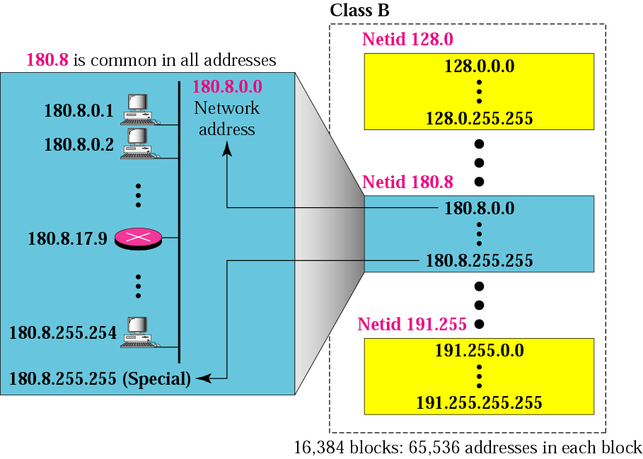
Figure 4.8 Blocks in class B
TCP/IP Protocol Suite

Slide 32
Note:
Many class B addresses are wasted.
TCP/IP Protocol Suite

Slide 33

Figure 4.9 Blocks in class C
TCP/IP Protocol Suite

Slide 34
Note:
The number of addresses in class C is smaller than the needs of most organizations.
TCP/IP Protocol Suite

Slide 35
Note:
Class D addresses are used for multicasting; there is only one block in this class.
TCP/IP Protocol Suite

Slide 36
Note:
Class E addresses are reserved for future purposes; most of the block is wasted.
TCP/IP Protocol Suite

Slide 37
Note:
In classful addressing, the network address (the first address in the block) is the one that is assigned to the organization. The range of addresses can automatically be inferred from the network address.
TCP/IP Protocol Suite

Slide 38
Example 9
Given the network address 17.0.0.0, find the class, the block, and the range of the addresses.
Solution
The class is A because the first byte is between 0 and 127. The block has a netid of 17. The addresses range from 17.0.0.0 to 17.255.255.255.
TCP/IP Protocol Suite

Slide 39
Example 10
Given the network address 132.21.0.0, find the class, the block, and the range of the addresses.
Solution
The class is B because the first byte is between 128 and 191. The block has a netid of 132.21. The addresses range from 132.21.0.0 to 132.21.255.255.
Ans
TCP/IP Protocol Suite

Slide 40
Example 11
Given the network address 220.34.76.0, find the class, the block, and the range of the addresses.
Solution
The class is C because the first byte is between 192 and 223. The block has a netid of 220.34.76. The addresses range from 220.34.76.0 to 220.34.76.255.
Ans
TCP/IP Protocol Suite

Slide 41
Note:
The network address is the beginning address of each block. It can be found by applying the default mask to any of the addresses in the block (including itself). It retains the netid of the block and sets the hostid to zero.
TCP/IP Protocol Suite

Slide 42
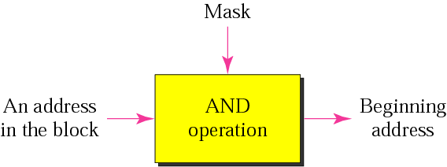
Figure 4.10 Masking concept

Slide 43
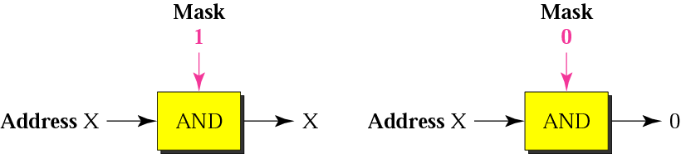
Figure 4.11 AND operation
TCP/IP Protocol Suite

Slide 44
Example 12
Given the address 23.56.7.91, find the beginning address (network address).
Solution
The default mask is 255.0.0.0, which means that only the first byte is preserved and the other 3 bytes are set to 0s. The network address is 23.0.0.0.
00010111 00111000 00000111 01011011
11111111 00000000 00000000 00000000
00010111 00000000 00000000 00000000
23 0 0 0
TCP/IP Protocol Suite

Slide 45
Example 13
Given the address 132.6.17.85, find the beginning address (network address).
Solution
The default mask is 255.255.0.0, which means that the first 2 bytes are preserved and the other 2 bytes are set to 0s. The network address is 132.6.0.0.
TCP/IP Protocol Suite

Slide 46
Example 14
Given the address 201.180.56.5, find the beginning address (network address).
Solution
The default mask is 255.255.255.0, which means that the first 3 bytes are preserved and the last byte is set to 0. The network address is 201.180.56.0.
TCP/IP Protocol Suite

Slide 47
Note:
Note that we must not apply the default mask of one class to an address belonging to another class.
TCP/IP Protocol Suite

Slide 48
4.4 SUBNETTING AND
SUPERNETTING
In the previous sections we discussed the problems associated with classful addressing. Specifically, the network addresses available for assignment to organizations are close to depletion. This is coupled with the ever-increasing demand for addresses from organizations that want connection to the Internet. In this section we briefly discuss two solutions: subnetting and supernetting.
The topics discussed in this section include:
Subnetting
Supernetting
Supernet Mask
Obsolescence
TCP/IP Protocol Suite

Slide 49
Note:
IP addresses are designed with two levels of hierarchy.
TCP/IP Protocol Suite

Slide 50
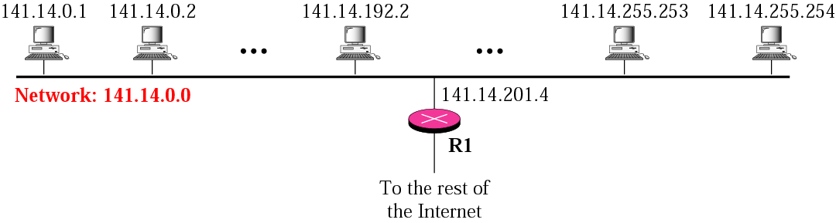
Figure 4.20 A network with two levels of hierarchy (not subnetted)
TCP/IP Protocol Suite

Slide 51
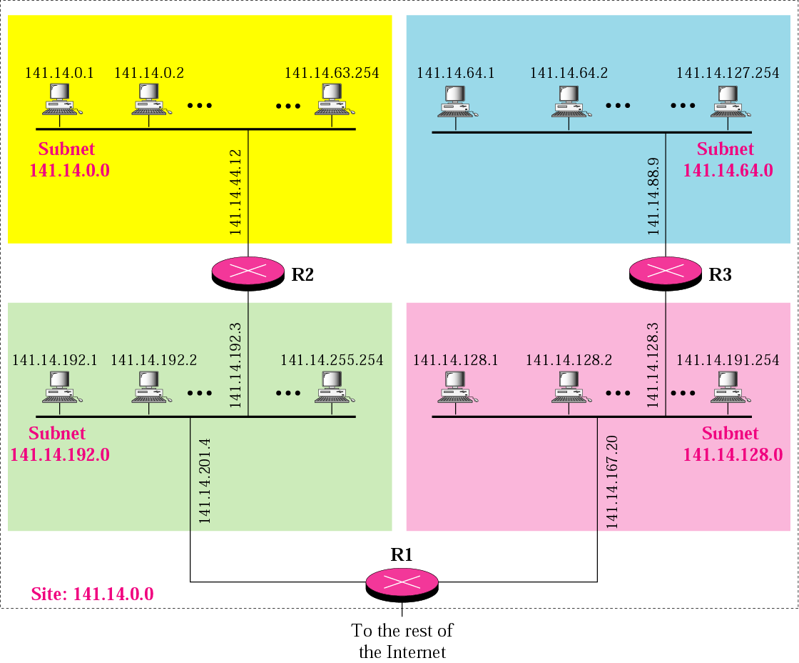
Figure 4.21 A network with three levels of hierarchy (subnetted)
TCP/IP Protocol Suite

Slide 52
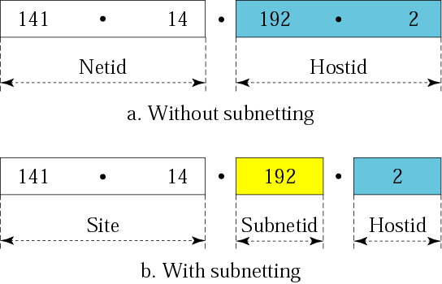
Figure 4.22 Addresses in a network with and without subnetting
TCP/IP Protocol Suite

Slide 53

Figure 4.23 Hierarchy concept in a telephone number
TCP/IP Protocol Suite

Slide 54
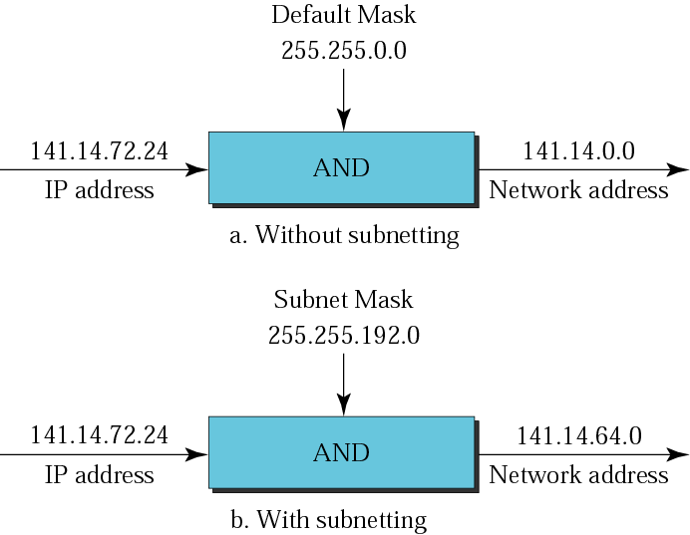
Figure 4.24 Default mask and subnet mask
TCP/IP Protocol Suite

Slide 55
Example 15
What is the subnetwork address if the destination address is 200.45.34.56 and the subnet mask is 255.255.240.0?
Solution
We apply the AND operation on the address and the subnet mask.
Address ➡ 11001000 00101101 00100010 00111000
Subnet Mask ➡ 11111111 11111111 11110000 00000000
Subnetwork Address ➡ 11001000 00101101 00100000 00000000.
TCP/IP Protocol Suite

Slide 56
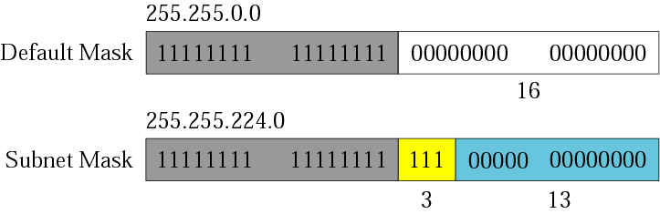
Figure 4.25 Comparison of a default mask and a subnet mask
TCP/IP Protocol Suite

Slide 57
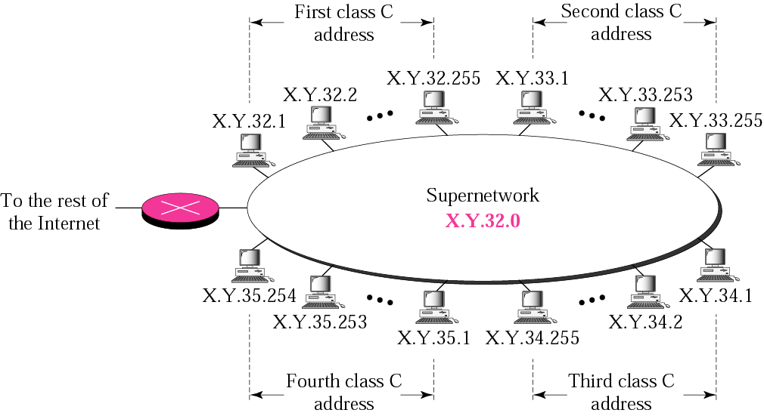
Figure 4.26 A supernetwork
TCP/IP Protocol Suite

Slide 58
Note:
In subnetting, we need the first address of the subnet and the subnet mask to define the range of addresses.
In supernetting, we need the first address of the supernet and the supernet mask to define the range of addresses.
TCP/IP Protocol Suite

Slide 59
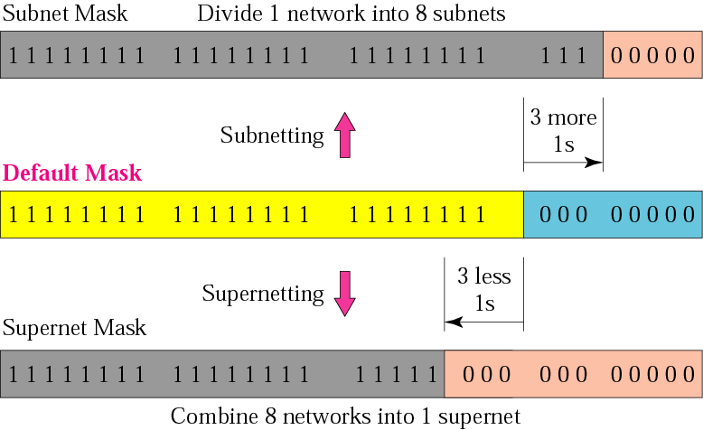
Figure 4.27 Comparison of subnet, default, and supernet masks
TCP/IP Protocol Suite

Slide 60
Note:
The idea of subnetting and supernetting of classful addresses is almost obsolete.
TCP/IP Protocol Suite

